Slide 1
Distributed Random Forest ENGR-E 599 : High Performance Big Data Systems
By Sumeet Mishra & SRInithish k
25th February,2019

Slide 2
Introduction
The Distributed Random Forests algorithm specifically targets implementation in cluster environments and attempts to optimize the performance in speed and accuracy. It is a powerful classification and regression tool. When given a set of data, it generates a forest of classification trees, rather than a single classification. Each of these trees is a weak learner built on a subset of rows and columns. Random Forest employs a number of techniques to reduce variance in predictions while maintaining (to some extent) the low variance that was characteristic of the lone Decision Tree. Classification takes the majority prediction over all of their trees to make a final prediction.

Slide 3

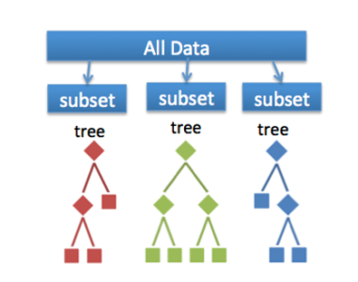
Algorithm & Dataset
Implemented decision tree algorithm from scratch.
Implemented Random forest algorithm from scratch.
Two approaches Sequential and Parallel were attempted.
Improved the accuracy in the parallel approach by splitting at 4 quartiles.
Airline dataset was used and a variable IsDelayed was created denoting if the flight got delayed. The same was used as target variable.
Parallel
Majority Vote

Slide 4
Methodology
We used Spark over Hadoop’s YARN cluster manager.
Spark is used for large scale batch processing or stream data processing on distributed systems.
Parallelised the growth of decision trees.
Tensorflow,on the otherhand, is a open source software library for high performance numerical computation. It is mainly used for distributed neural networks.
Tensorflow implementation of random forest is relatively new. That’s why we choose it to be part of our experiment.

Slide 5
Spark Single Node Implementation Results
Non Parallel Approach-
Accuracy: 0.811569912048
Time elapsed is 886.3815064430237s
Parallel Approach-
F1Score : 0.811978078528
Time elapsed: 198.5017282962799s
Parallel with splitting at 4 quartiles-
F1Score : 0.838975352622
Time elapsed: 232.465384483337s

Slide 6
Further Experiments
Implementation of parallized forest using spark on multiple nodes.
TensorFlow Implementation of random forest.
Tensorflow implementation on multiple nodes.
Comparing performance between them.

Slide 7
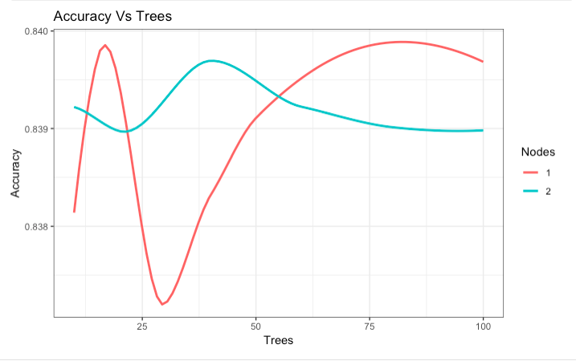
Implementation of parallized forest using spark on multiple nodes.
We implemented parallized forest on Spark and scaled it to multiple nodes.
Performance for both nodes on spark
Accuracy VS Trees
Time Vs Trees

Slide 8
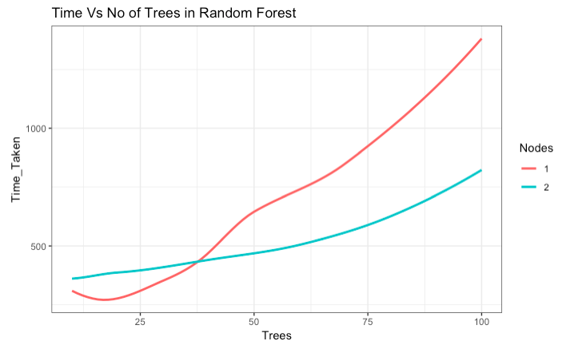
Spark: Time vs number of trees

Slide 9
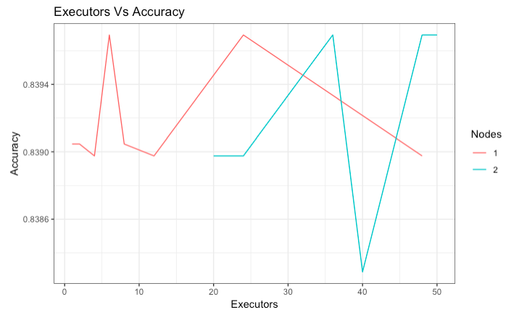
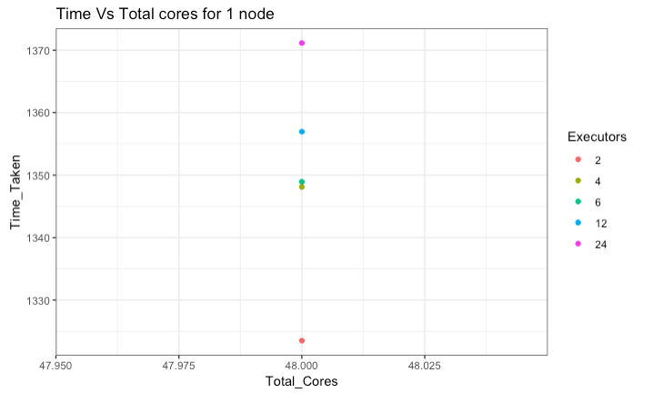
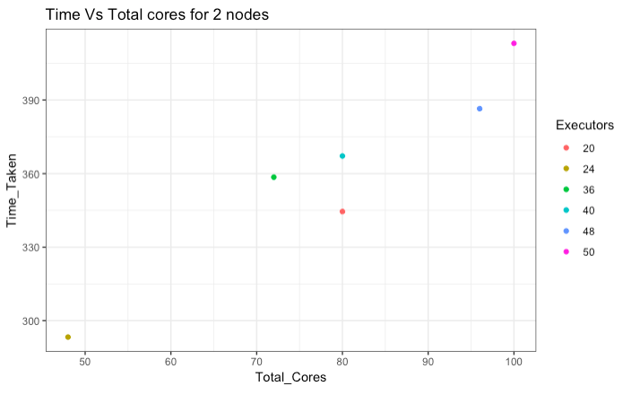
Performance Comparison for Spark for few more parameters
Executor VS Accuracy
Time Vs TotalCores for single node
Time Vs TotalCores for two nodes

Slide 10
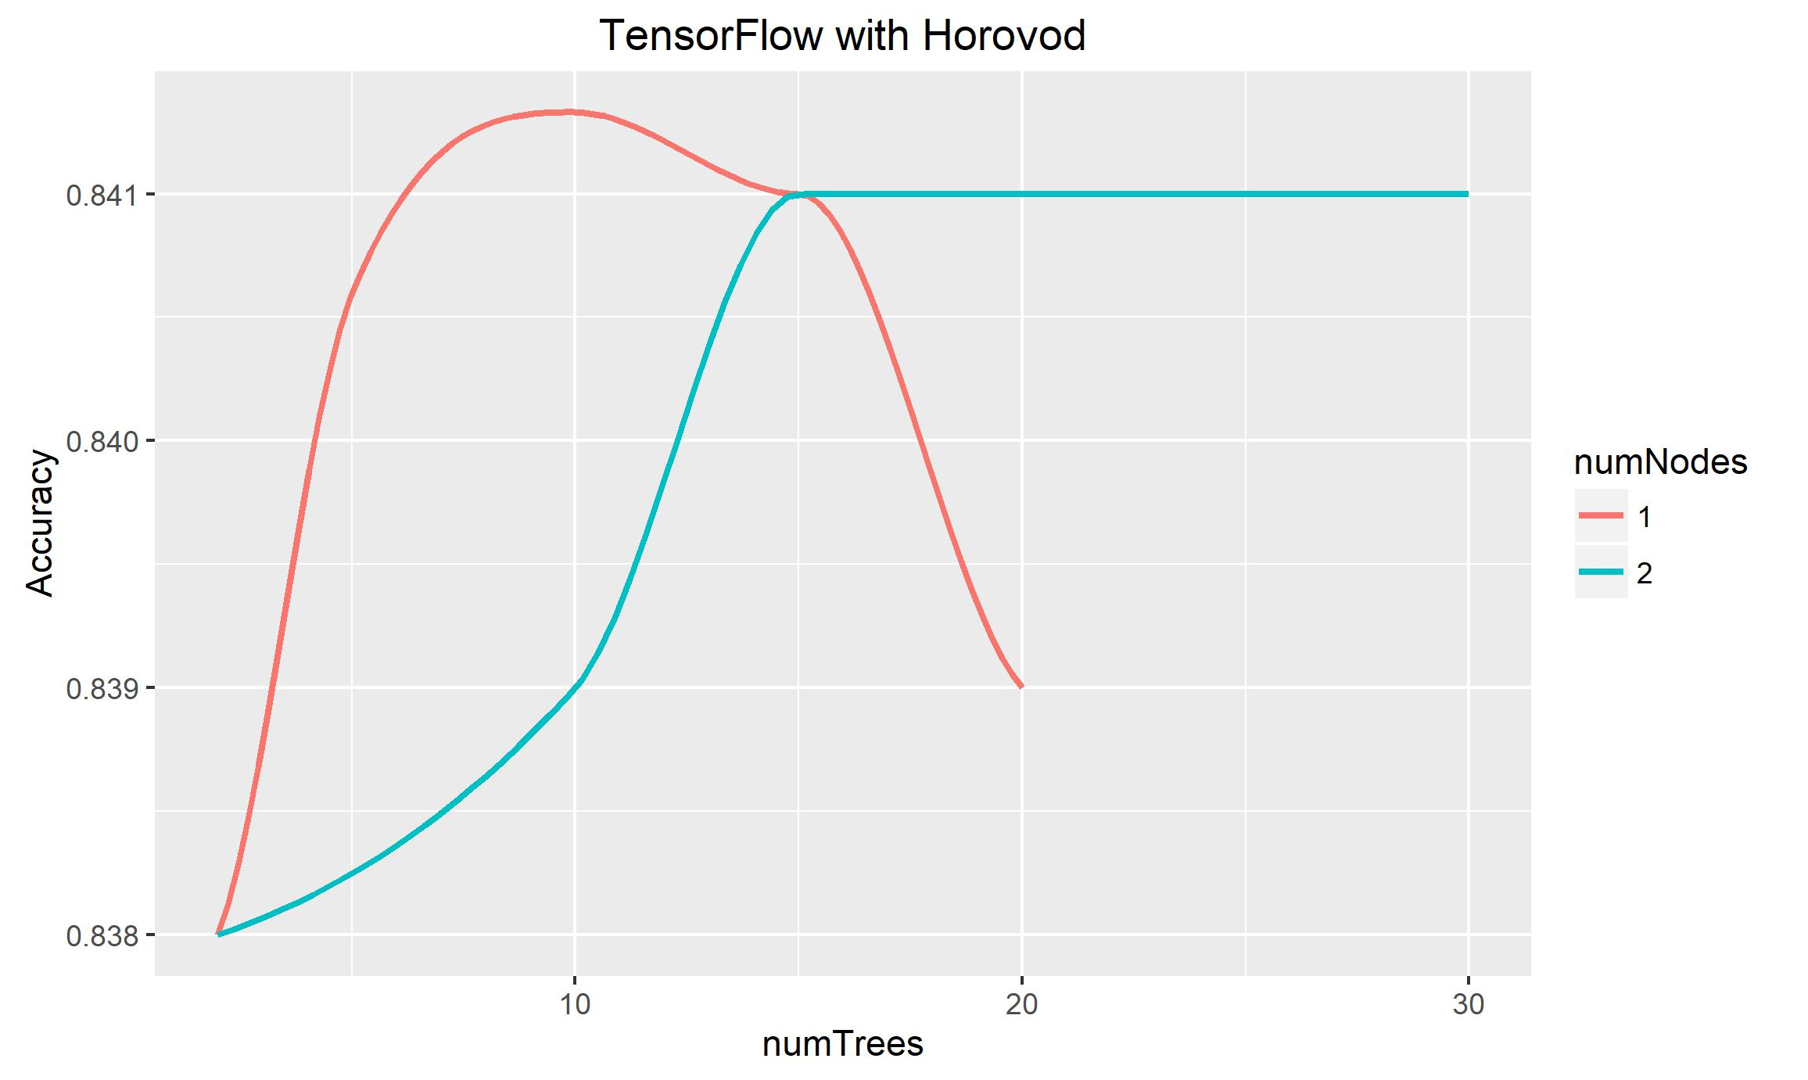
TensorFlow Implementation of random forest
We implemented random forest on tensorflow.
Used Horovod and MPI AllGather
Performance for both nodes on Tensorflow
ComputationTime Vs Number of Trees
Accuracy VS Number of Trees

Slide 11
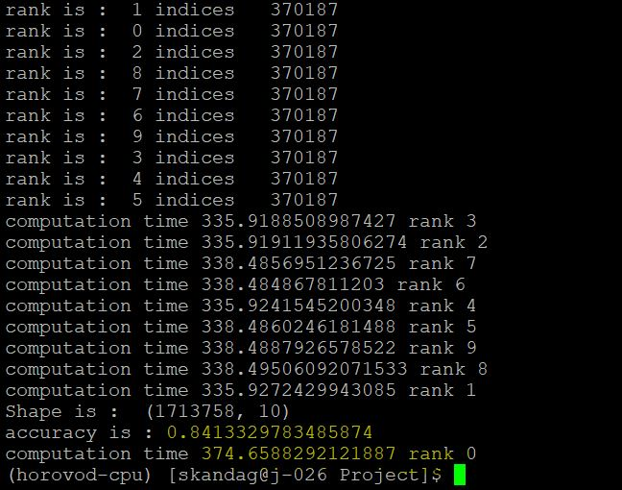

Tensorflow with Horovod

Slide 12
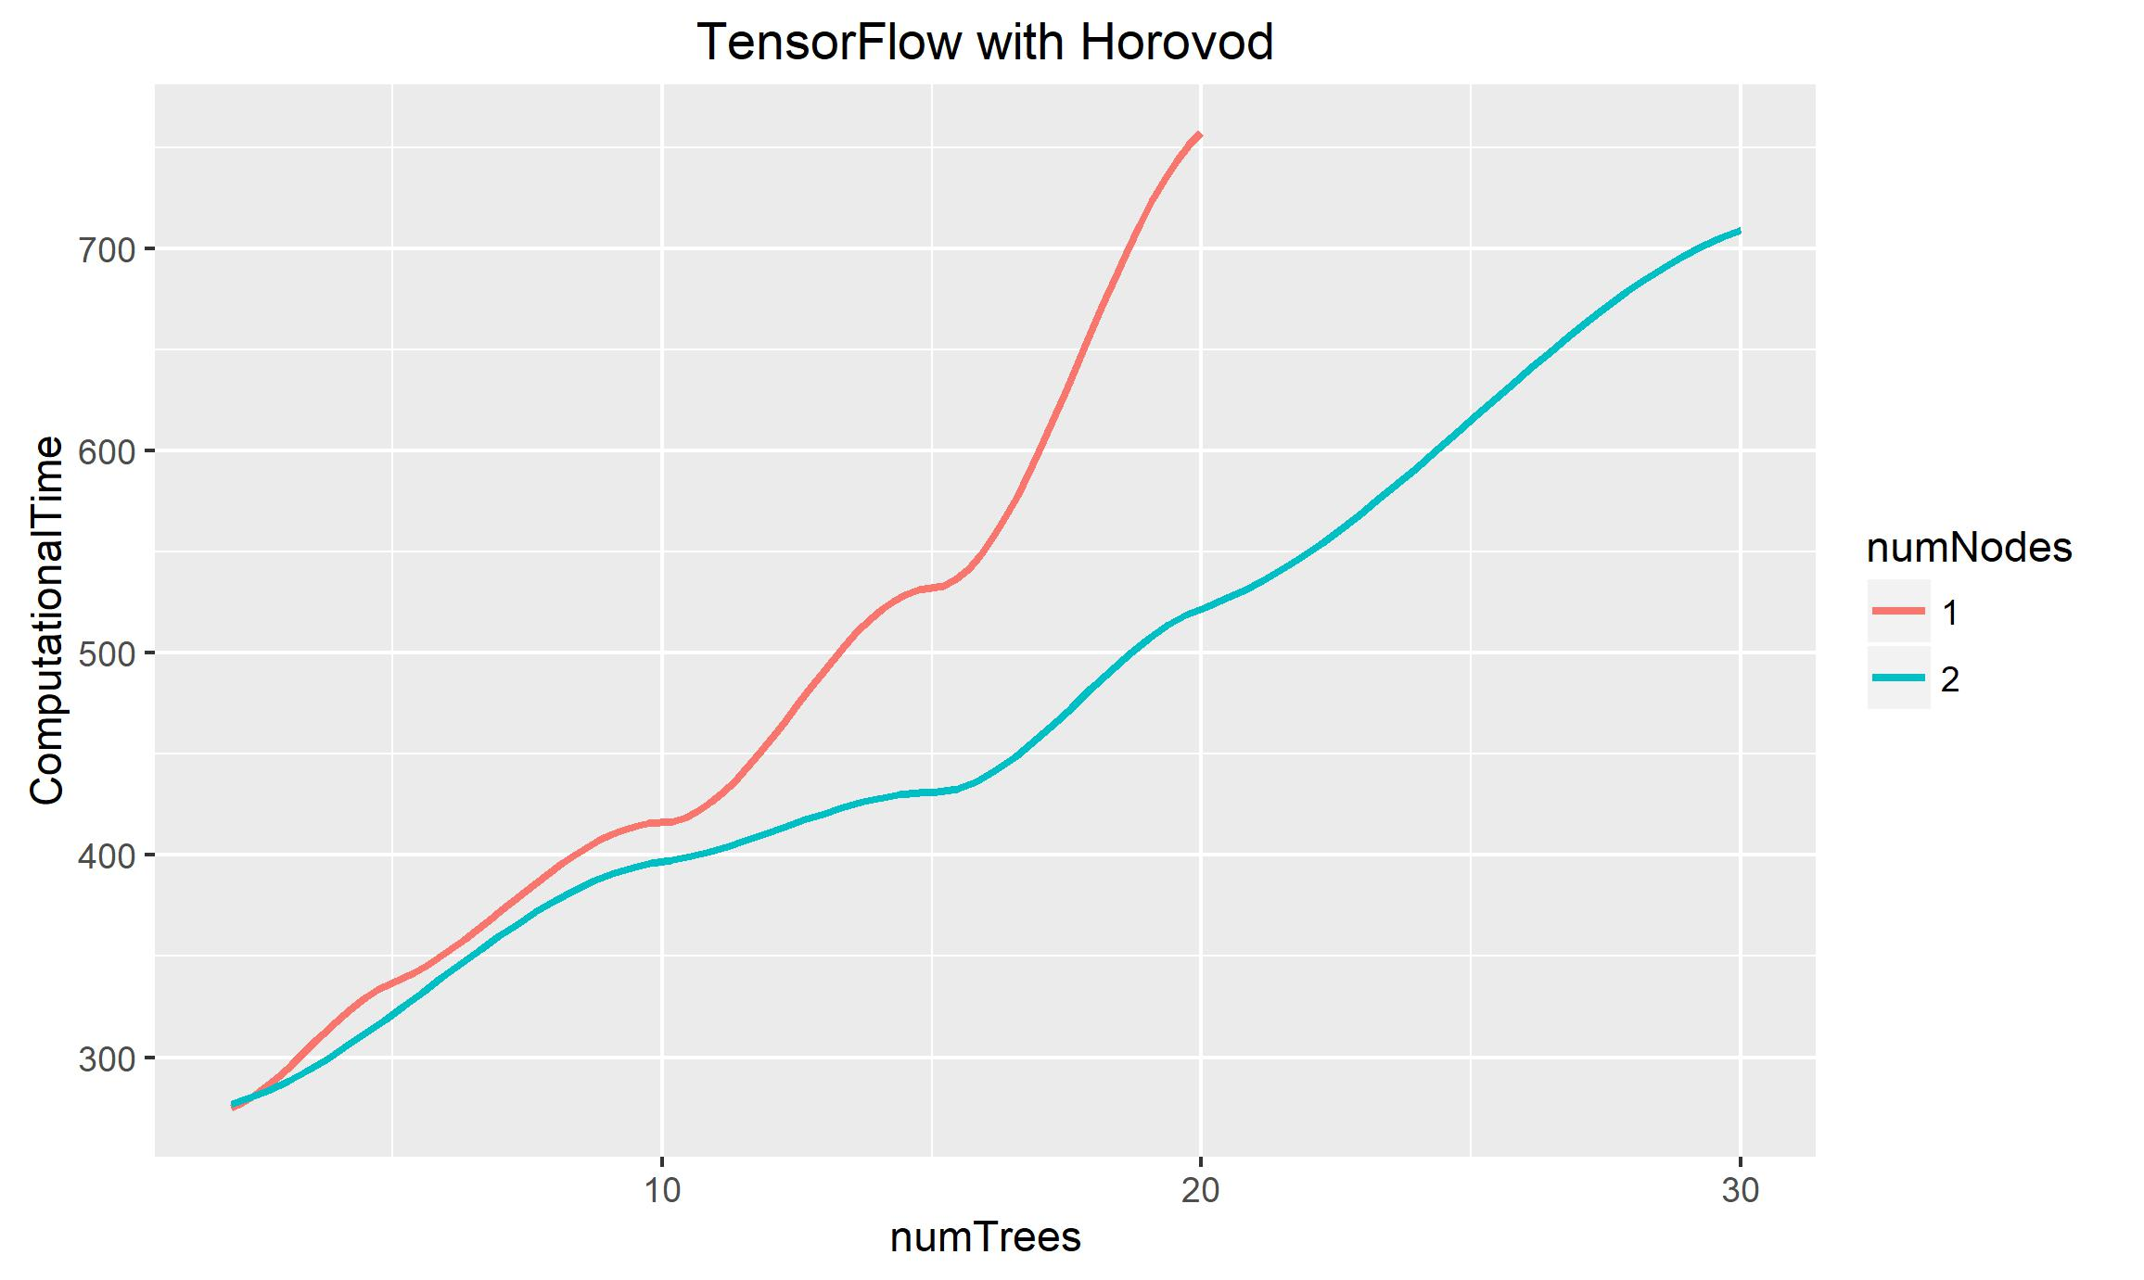
Tensorflow: Time taken vs number of trees

Slide 13
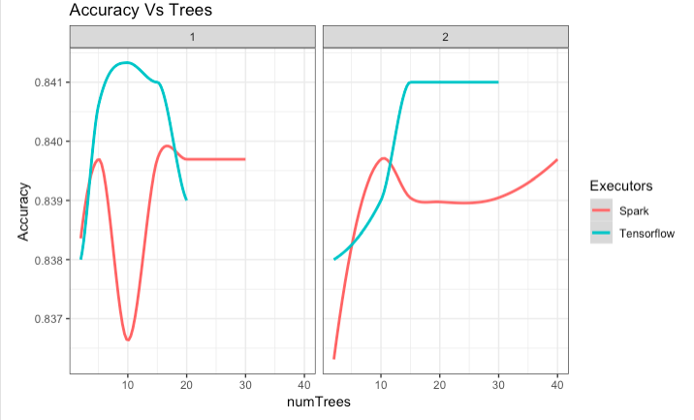
Performance comparison between Spark and Tensorflow
Performance between Spark and Tensorflow
Accuracy VS Number of Trees
ComputationTime Vs Number of Trees

Slide 14
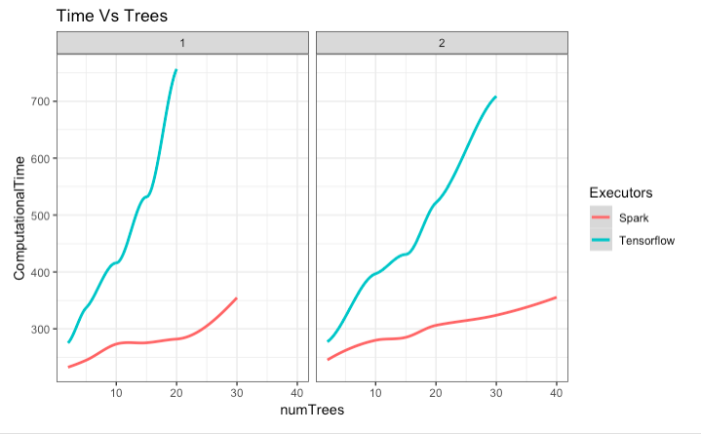
SparkVSTensorflow:ComputationTime Vs Number of Trees

Slide 15
Conclusion
Spark: Parallelization of the forest decreased the computation time by a factor of 4. Modifying the splitting criteria allowed to improve the accuracy by 3.5%.
Tensorflow: Parallelization of the forest for tensorflow decreased the computation time by a factor of 3.3.
In both spark and tensorflow the reduction in time was on a factor of 3 to 4.
Comparison between Spark and Tensorflow: From our experiment spark achieved better performance in terms of computation time while Tensorflow achieved slightly better accuracy.

Slide 16
Thank You

Slide 17
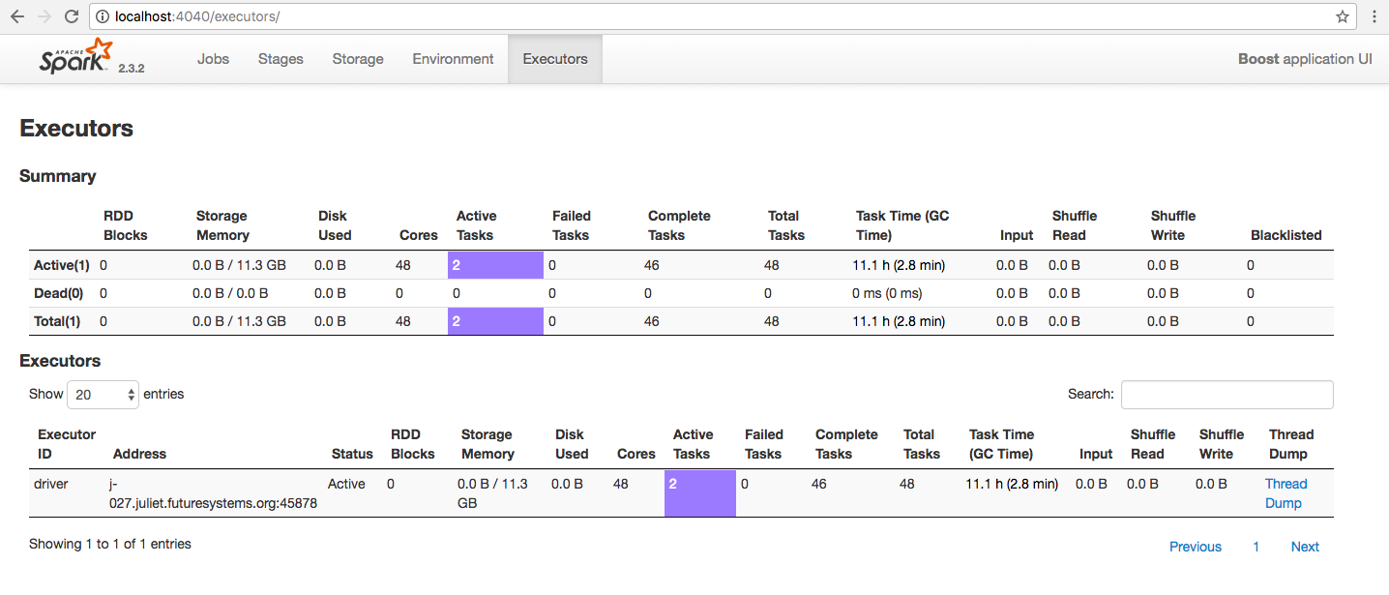
Apendix

Slide 18
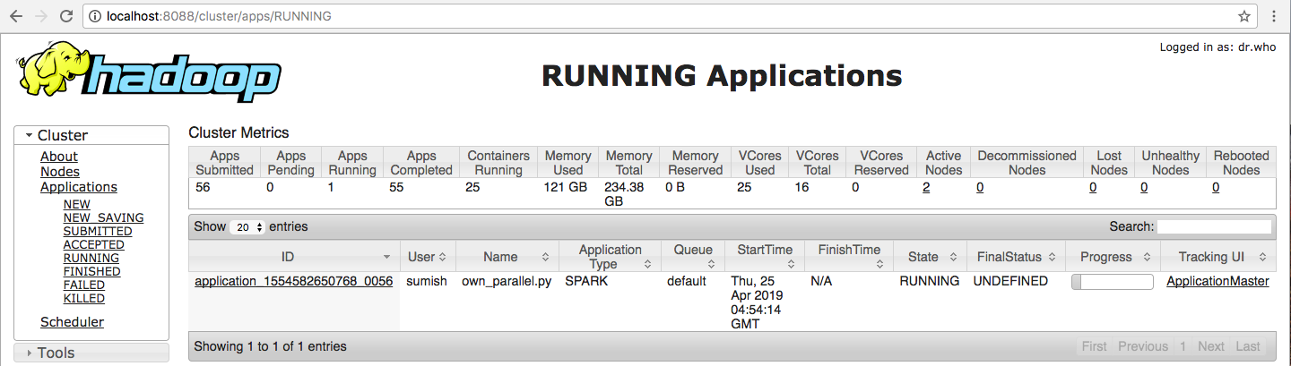

Slide 19
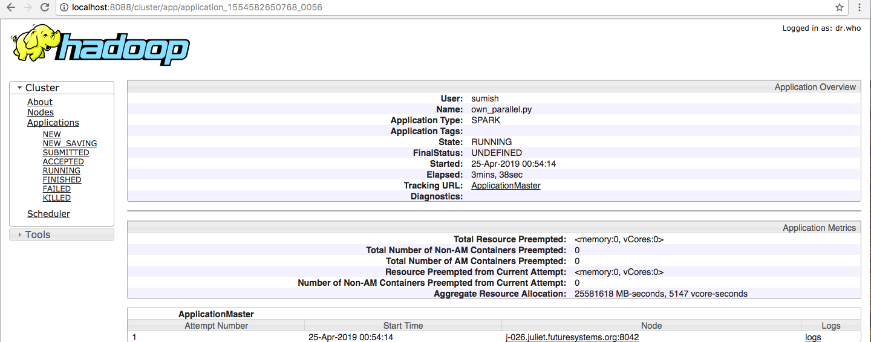

Slide 20
